Slide 1
Serveless App Examples
Pravin Y Pawar

Slide 2
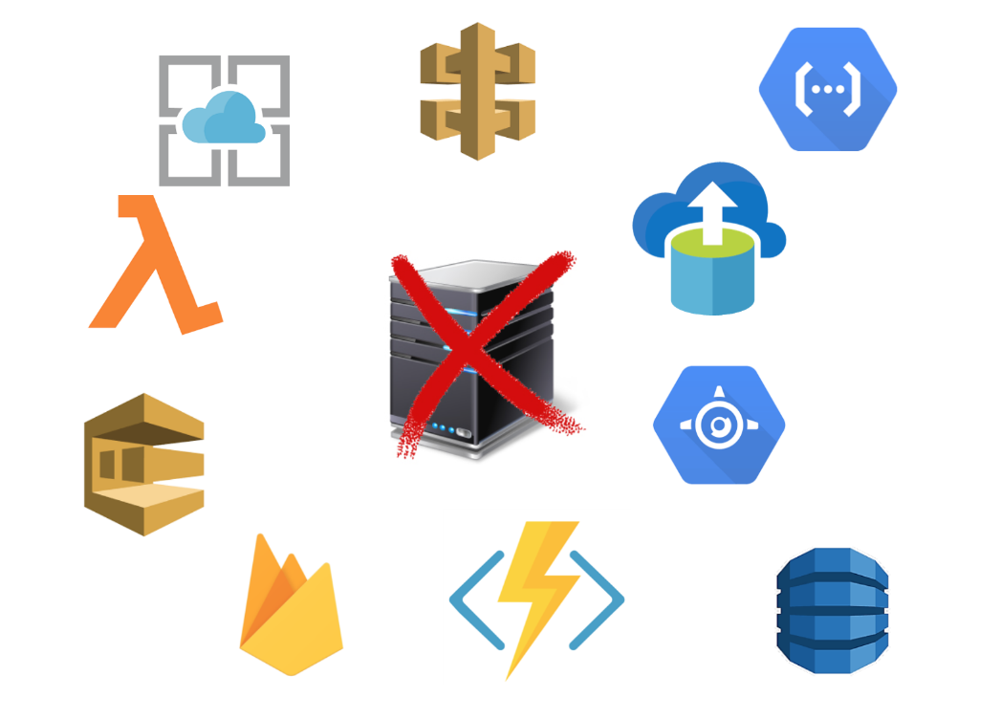
Common architecture examples for Serverless
Many approaches to using serverless architectures
Some projects may benefit from taking an “all-in” approach to serverless
Applications that rely heavily on microservices may implement all microservices using serverless technology
The majority of apps are hybrid, following an N-tier design and using serverless for the components that make sense
Some common architecture examples that use serverless
Full serverless back end
Monoliths and “starving the beast”
Web apps
Mobile back ends
Internet of Things (IoT)
source : medium

Slide 3

Full Serverless back end
Ideal for several types of scenarios, especially when building new or “green field” applications
An application with a large surface area of APIs may benefit from implementing each API as a serverless function
Apps that are based on microservices architecture
Specific scenarios include:
API-based SaaS products (example: financial payments processor)
Message-driven applications (example: device monitoring solution)
Apps focused on integration between services (example: airline booking application)
Processes that run periodically (example: timer-based database clean-up)
Apps focused on data transformation (example: import triggered by file upload)
Extract Transform and Load (ETL) processes

Slide 4
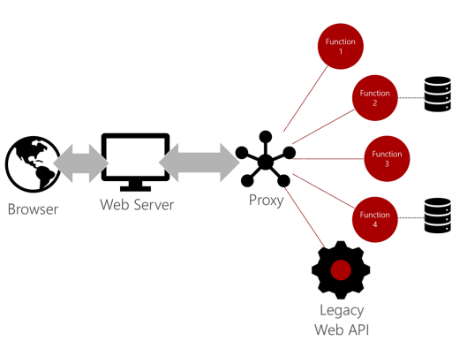
Monoliths and “starving the beast”
A common challenge is migrating an existing monolithic application to the cloud
The least risky approach is to “lift and shift” entirely onto virtual machines
Many shops prefer to use the migration as an opportunity to modernize their code base
A practical approach to migration is called “starving the beast”
the monolith is migrated “as is” to start with
then, selected services are modernized
clients are updated to use the new service rather than the monolith endpoint
eventually, all clients are migrated onto the new services
The monolith is “starved” (its services no longer called) until all functionality has been replaced
The combination of serverless and proxies can facilitate much of this migration
source : Microsoft

Slide 5
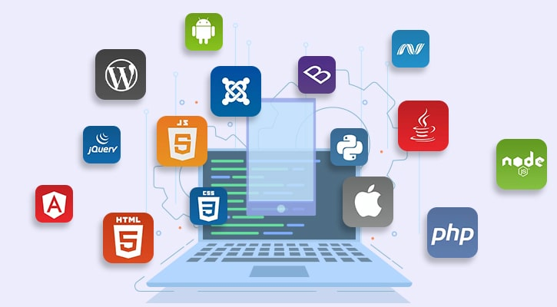
Web apps
Web apps are great candidates for serverless applications
Two common approaches to web apps today:
server-driven
client-driven (such as Single Page Application or SPA)
Server-driven web apps typically use a middleware layer to issue API calls to render the web UI
SPA make REST API calls directly from the browser
In both scenarios, serverless can accommodate the middleware or REST API request by providing the necessary business logic
A common architecture is to stand up a lightweight static web server
The Single Page Application (SPA) serves HTML, CSS, JavaScript, and other browser assets
The web app then connects to a microservices back end
source : peerbits

Slide 6
Mobile back ends
The event-driven paradigm of serverless apps makes them ideal as mobile back ends
The mobile device triggers the events and the serverless code executes to satisfy requests
Taking advantage of a serverless model enables developers to enhance business logic without having to deploy a full application update
The serverless approach also enables teams to share endpoints and work in parallel
Mobile developers can build business logic without becoming experts on the server side
Serverless abstracts the server-side dependencies and enables the developer to focus on business logic
For example,
A mobile developer who builds apps using a JavaScript framework can build serverless functions with JavaScript as well
The serverless host manages the operating system, a Node.js instance to host the code, package dependencies, and more
The developer is provided a simple set of inputs and a standard template for outputs
They then can focus on building and testing the business logic.

Slide 7
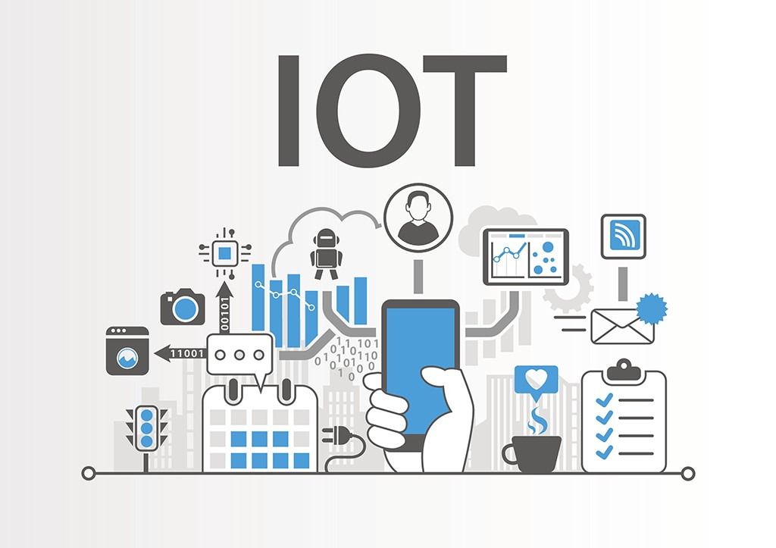
Internet of Things (IoT)
IoT refers to physical objects that are networked together aka “connected devices” or “smart devices.”
Everything from cars and vending machines may be connected and send information
ranging from inventory to sensor data such as temperature and humidity
For example,
In the enterprise, IoT provides business process improvements through monitoring and automation
IoT data may be used to regulate the climate in a large warehouse or track inventory through the supply chain
IoT can sense chemical spills and call the fire department when smoke is detected.
Serverless is an ideal solution for several reasons:
Enables scale as the volume of devices and data increases
Accommodates adding new endpoints to support new devices and sensors
Facilitates independent versioning so developers can update the business logic for a specific device without having to deploy the entire system
Resiliency and less downtime
Automates tasks such as device registration, policy enforcement, tracking, and even deployment of code to devices at the edge
source : medium

Slide 8
Thank You!
Reference:
Serverless apps Architecture patterns and Azure implementation
By Microsoft
In our next session:

